Slide 1


Slide 2
Agenda – Day 1
Introduction
What is a computer program?
Introducing App Inventor
Getting hands on with App Inventor
Lunch Break
Creating the Mole Mash Game

Slide 3
Agenda – Day 2
Complete Mole Mash Game
Lunch Break
Creating the Bowling Game

Slide 4
Agenda – Day 3
Complete the Bowling Game
Conceive your own app for classroom use
Lunch Break
Implement your app

Slide 5
Rowan Academy of Mobile Programming (RAMP)
Mobile application programming can provide an authentic and engaging hook into computer science. The MIT App Inventor is a visual programming environment that enables students with no programming background to build apps for Android mobile devices. We will use this at Rowan University to teach CS Principles to K-12 students and educators by empowering them to create their own mobile apps and engage them personally, as well as infusing energy and excitement into computer science education.
For more information contact:
John Robinson, robinsonj@rowan.edu, 856-256-4778

Slide 6
The College Board and NSF CS Big Ideas
Big Idea I: Creativity
Big Idea II: Abstraction
Big Idea III: Data
Big Idea IV: Algorithms
Big Idea V: Programming
Big Idea VI: Internet
Big Idea VII: Global Impact

Slide 7
Introduction
You may quickly and easily create applications or “apps” for android smartphones and tablets.
With App Inventor, you use a screen designer to visually create an app’s screen (Figure 1-1).
Then you use a special editor known as the Blocks Editor to create the actions.
You visually assemble code blocks (Figure 1-2).

Slide 8
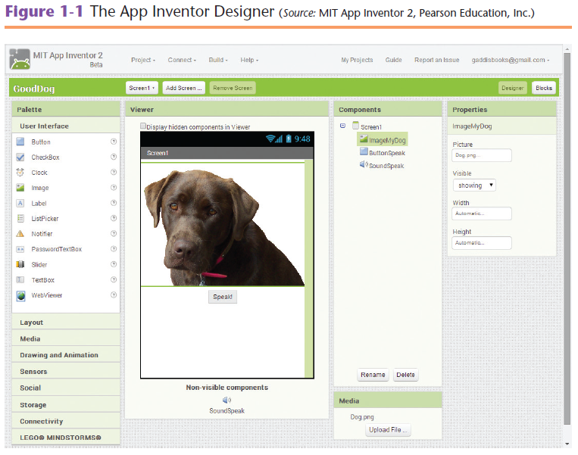
Introduction

Slide 9
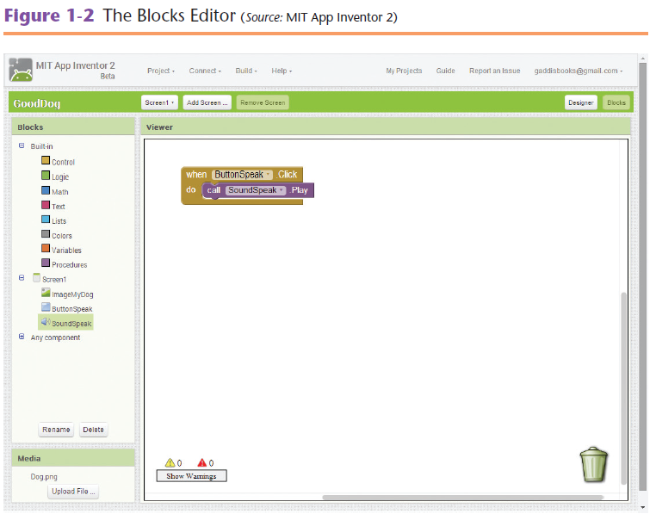
Introduction

Slide 10
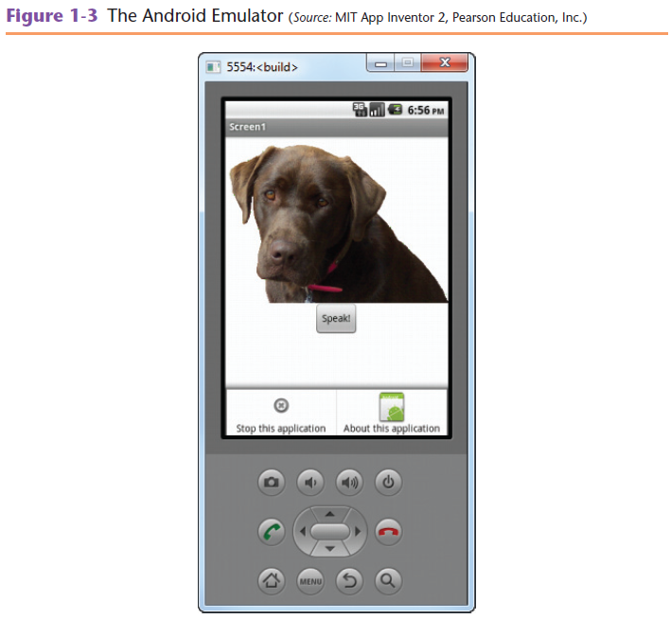
Introduction
App Inventor provides an Android emulator that runs on your computer.
The emulator (Figure 1-3) is a simulated Android phone.

Slide 11
Introduction
App Inventor Runs in the Cloud.
App Inventor is part of MIT’s Center for Mobile Learning.
Advantages of the cloud-based approach
You can access App Inventor from any computer connected to the Internet.
Your files are maintained and backed up by the host.
You can be sure you are always running the most recent version of App Inventor.

Slide 12
What Is a Computer Program?
A computer program is a set of instructions that a computer follows to perform a task.
A computer is a device that follows instructions for manipulation and storing data.
When a computer is performing the instructions, we say it is running or executing the program.

Slide 13
What Is a Computer Program?
Algorithms and Programming Languages
An algorithm is a set of well-defined, logical steps that must be taken in order to perform a task.
The instructions have to be translated into machine language.
In machine language, each instruction is represented by a binary number.
A binary number is a number that has only ones and zeros. Here is an example.
1011010000000101

Slide 14
What Is a Computer Program?
Algorithms and Programming Languages
Each language has its own syntax.
Syntax is a set of rules that must be strictly followed.
In traditional programming languages you convert your algorithm into a set of statements.
Programmers call the statements code.
An executable program is a file containing machine language instructions that can be directly executed by the computer.

Slide 15
What Is a Computer Program?
Programming with App Inventor
Beginning programmers frequently make typing mistakes resulting in syntax errors.
In App Inventor, syntax errors never happen, because you do not type programming statements.
Instead you drag and drop code blocks.
The blocks can be “snapped” together like pieces of a puzzle.

Slide 16
Introducing App Inventor
Each time you work with App Inventor you will perform the following steps:
Open a browser and go to the App Inventor website.
Either create a new project or open an existing project.
Open The Blocks Editor.
Connect either the Android emulator or an actual Android device.

Slide 17
Introducing App Inventor
The Designer
The Designer is organized into the following columns:
The Pallet column.
The Viewer column.
The Components column.
The Media column.
The Properties column.

Slide 18
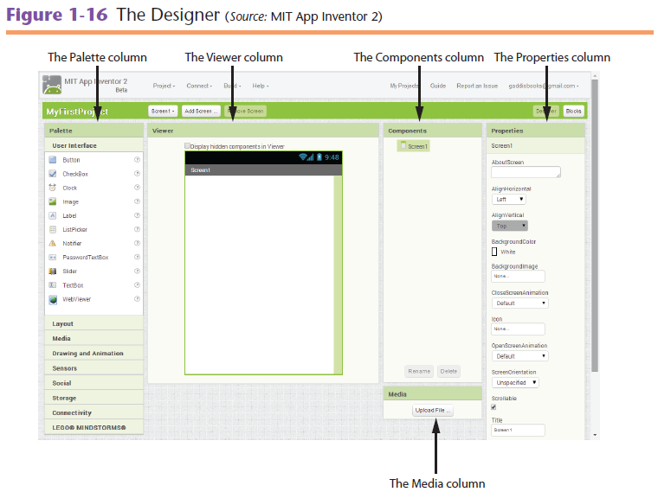
Introducing App Inventor

Slide 19
Introducing App Inventor
The Palette Column
The Pallet provides a list of components.
A component is an item that performs a specific purpose within an app.

Slide 20
Introducing App Inventor
The different sections of the palette are:
User interface – The fundamental component for building an app’s screen.
Layout – Provides components for organizing other components on the app’s screen.
Media –
Provides components for taking photos.
Recording and playing videos.
Recording and playing sounds.
Picking Images.

Slide 21
Introducing App Inventor
The different sections of the palette are:
Drawing and Animation – Provides components for creating simple drawings and animations.
Sensors – Allows your app to access the device’s accelerometer.
Social – Works with the phones contact list.
Storage – These components store data locally on a device or remotely on the Web server.
Connectivity – Provides components for launching external applications.

Slide 22
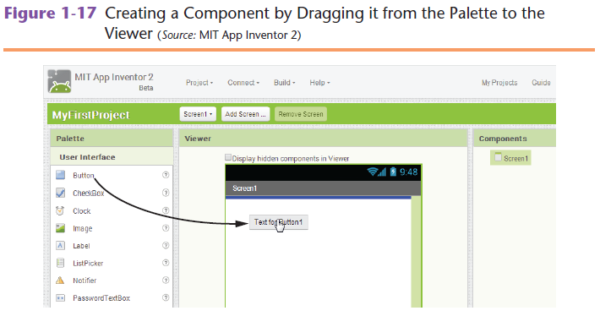
Introducing App Inventor
The Viewer Column
You design an apps user interface by dragging components from the Pallet onto the simulated screen in the Viewer.
Components you place on the simulated screen in the Viewer might appear slightly different on the emulator screen.

Slide 23
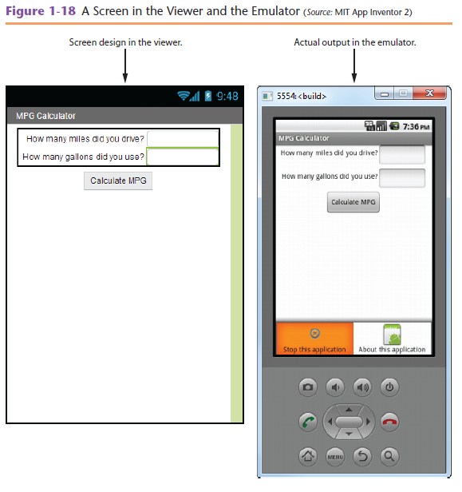
Introducing App Inventor
Notice the shapes of the text boxes and buttons are slightly different between the two screens.

Slide 24
Introducing App Inventor
The Components Column
Shows a hierarchical tree listing all of the components that you have placed your app.
The Media Column
Allows you to manage the media files (images, videos, and audio files).

Slide 25
Introducing App Inventor
The Properties Column
A Components appearance and other characteristics are determined here. Here are some examples:
Label component – To display text on your devices screen.
Image component – To display an image under the device’s screen.
Sound component – If you want the app to play a sound.

Slide 26
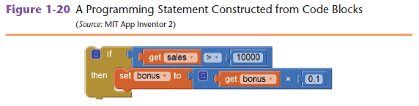
Introducing App Inventor
Block’s Editor
A block is a shape that looks like a puzzle piece.

Slide 27
Introducing App Inventor
The blocks column is organized in the following manner:
Built-In – The basic blocks that make up the App Inventor language.
Screen1 – Each time you add a component to Screen1 in the Designer, a set of component blocks are added to the section.
Any component – Allows a programmer to work with any component in the app.

Slide 28
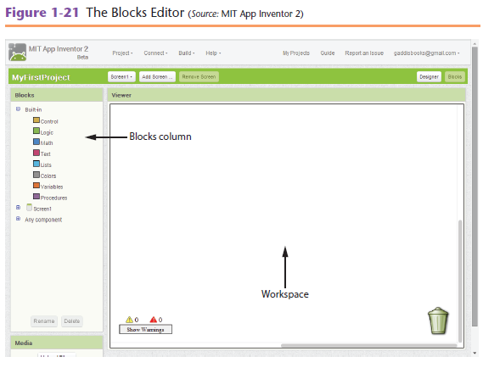
Introducing App Inventor

Slide 29
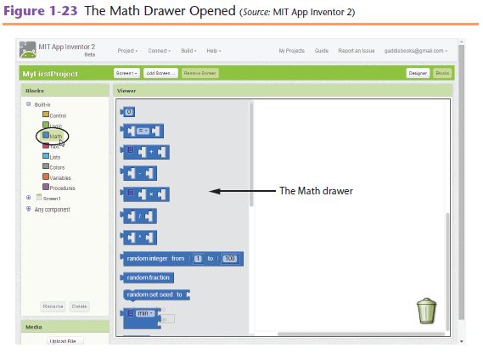
Introducing App Inventor
The Built-in blocks
Figure 1-23 Shows what happens when you click Math

Slide 30
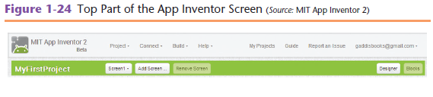
Introduction
The top part of the App Inventor screen shows the following items:
Project – Start, save, and export projects.
Connect – Connect to an Android device or the Android emulator.
Build – Package an app so it can be shared.
Help – Provides access to documentation, tutorials, and the App Inventor forum.

Slide 31
Introducing App Inventor
My Projects – Displays a list of all the App Inventor projects that you have created.
Guide – Opens a separate Web page containing the App Inventor documentation.
Report an Issue – Takes you to the App Inventor support forum.

Slide 32
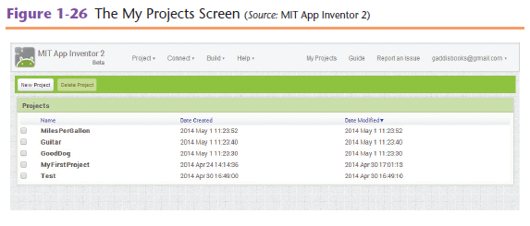
Getting Hands-On with App Inventor
Managing Projects
Get to the My Projects screen by going to appinventor.mit.edu.
Click the Create button.
The New button creates a new project.
The Delete button deletes the project.

Slide 33
Getting Hands-On with App Inventor
The App’s Screen1 Component
A Screen is the most fundamental type of component.
Each component in the app must have a unique name.
By default an empty Screen component is named Screen1.
You will want to change the default name to something meaningful.

Slide 34
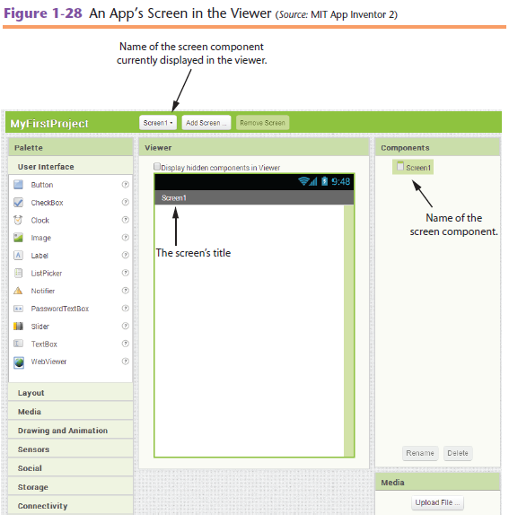
Getting Hands-On with App Inventor

Slide 35
Getting Hands-On with App Inventor
Working with the Properties Column
Component properties are displayed in the Properties column.
In Figure 1-29 notice the propertie’s name is Title.
Usually you will want to change the value of Screen1 one complements the title property or something meaningful.

Slide 36
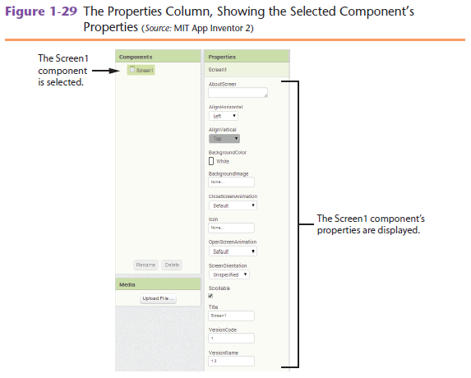
Getting Hands-On with App Inventor

Slide 37
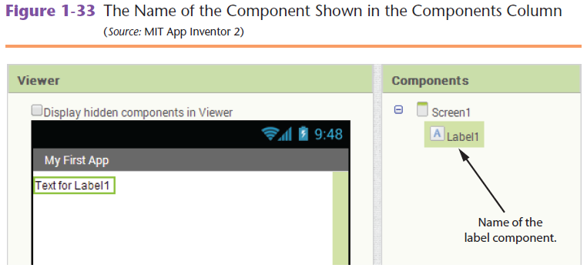
Getting Hands-On with App Inventor
Label Components
A Label compound it displays text on the app’s screen.
Create a Label component by dragging it from the User Interface section of the Pallet onto the app’s screen in the Viewer.
Figure 1-33 shows the Components column after a Label component has been created.

Slide 38
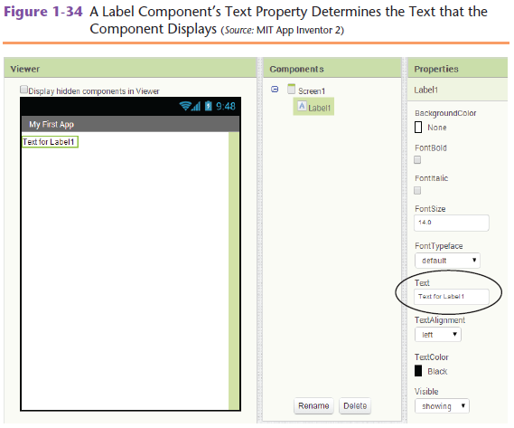
Getting Hands-On with App Inventor
Once you have created a Label component, set it’s text property to the text you want.

Slide 39
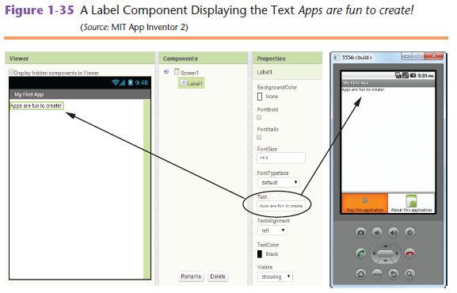
Getting Hands-On with App Inventor
Figure 1-35 Shows an app with the Label component.
The text property is set to Apps are fun to create!

Slide 40
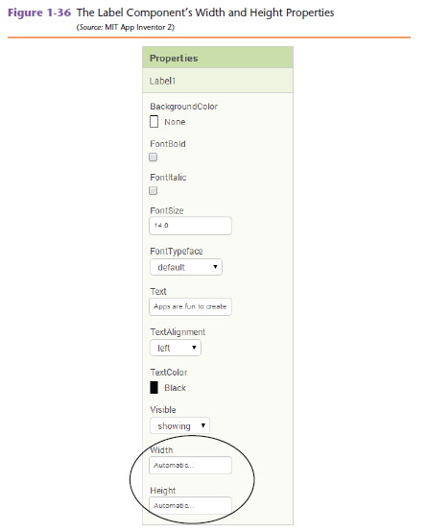
Getting Hands-On with App Inventor
Label Width and Height

Slide 41
Getting Hands-On with App Inventor
Property values you can set are Width and Height
Automatic – The component’s width will automatically adjust to accommodate the size of the label’s text.
Fill parent – The component will be as wide as the container.
A specified number of pixels – You can specify a number of pixels for a components width and/or height. You should avoid this in most cases, because different devices have different screen sizes.

Slide 42
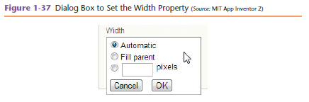
Getting Hands-On with App Inventor

Slide 43
Getting Hands-On with App Inventor
Changing a Component’s name
When you create a component, App Inventor automatically gives it a name.
Default names are not very descriptive.
Change the component’s name to something that is more meaningful.

Slide 44
Getting Hands-On with App Inventor
Changing a Components Name
In the Designer, you can use the Components column to change the name of any component (Except the Screen1 component). Do so by:
Clicking the name of the component in the Components column to select it.
Click the Rename button at the bottom of the components column.
The Rename Component dialog box shown in Figure 1-38 will appear.
Enter the component’s new name and click OK.

Slide 45
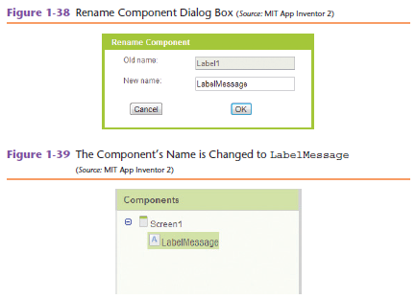
Getting Hands-On with App Inventor

Slide 46
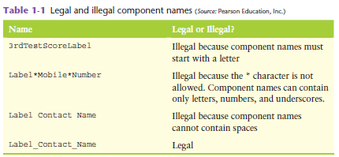
Getting Hands-On with App Inventor
Rules and Conventions for Naming Components
Component names can contain only letters, numbers, and underscores ( _ ).
The first character of the component name must be a letter.
Component names cannot contain spaces.

Slide 47
Getting Hands-On with App Inventor
Deleting Components
To delete a component, click the Delete button that appears at the bottom of the Component’s column.

Slide 48
Getting Hands-On with App Inventor
Button Components
Create a Button component by dragging it from the User Interface section of the Pallet to the app’s screen in the Viewer.
Once you create a Button component, you should change its name to something more descriptive.
You should also change the component’s text property to indicate what the button will do when it is clicked.

Slide 49
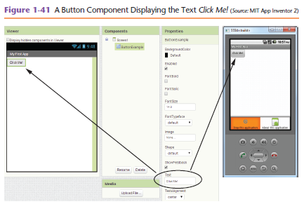
Getting Hands-On with App Inventor

Slide 50
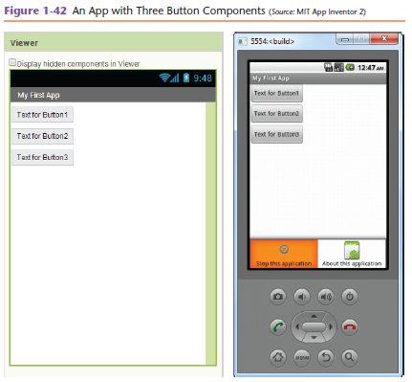
Getting Hands-On with App Inventor
Screen Alignment
Components are arranged vertically, from the top of the screen to the bottom of the screen.
By default they are aligned along the left edge of the screen.

Slide 51
Getting Hands-On with App Inventor
Screen alignment
Screen components and have an AlignHorizontal Property.
You can set the AlignHorizontal property to one of the following values:
Left – along the left edge of the screen.
Center – in the center of the screen.
Right – Along the right edge of the screen.

Slide 52
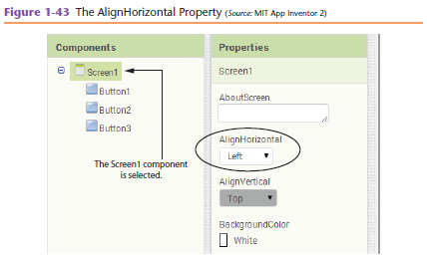
Getting Hands-On with App Inventor

Slide 53
Getting Hands-On with App Inventor
Screen Alignment
Screen components also have an AlignVertical property.
You can change the AlignVertical property only if the screen is not scrollable.
You can set the AlignVertical property to one of the following values:
Top – Along the top of the screen.
Center – In the center of the screen.
Bottom – Along the bottom of the screen.

Slide 54
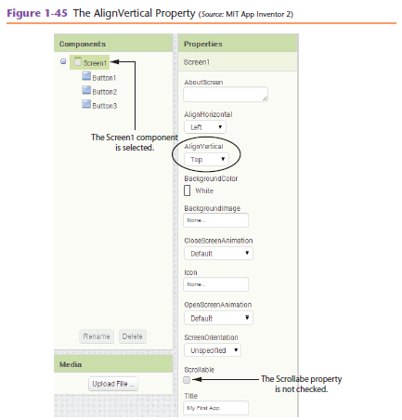
Getting Hands-On with App Inventor

Slide 55
Getting Hands-On with App Inventor
Programming with Blocks
Apps are event-driven programs.
When an app is running, it waits for a specific event to happen.
An event is an action such as the user clicking a button or sliding his or her finger across the device’s screen.
An incoming text message is also an event.
An event also occurs when the user tilts or shakes the phone.

Slide 56
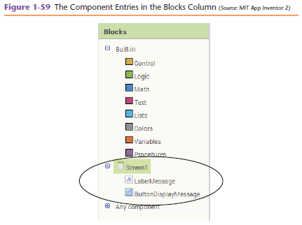
Getting Hands-On with App Inventor
Programming with Blocks
The Hello World app has a Button component named ButtonDisplayMessage.
And a Label component named LabelMessage
We need a block that executes when user clicks the ButtonDisplayMessage component.

Slide 57
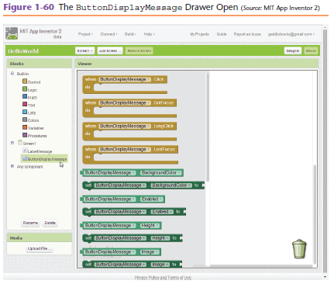
Getting Hands-On with App Inventor
Programming with Blocks
Because you want to create a block that executes when the ButtonDisplayMessage component is clicked, you need to click the ButtonDisplayMessage entry.

Slide 58
Getting Hands-On with App Inventor
Programming with Blocks
There are numerous blocks in this drawer. Here is a summary of the meaning of the colors.
Brown blocks are called event handlers.
An event handler is a block that automatically executes when he specific event takes place.
Light green blocks represent values that are related to the component.
Dark green blocks perform actions with the component.

Slide 59
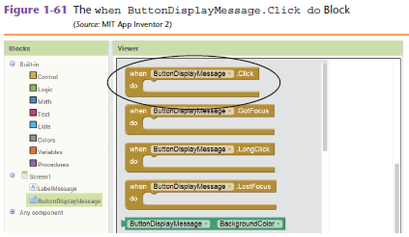
Getting Hands-On with App Inventor
Programming with Blocks
Figure 1-61 Shows the topmost block inside the drawer. It reads:
when ButtonDisplayMessage.Click do
This means when the ButtonDisplayMessage is clicked, do this block.

Slide 60
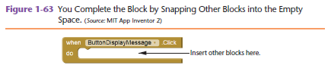
Getting Hands-On with App Inventor
Programming with Blocks
The ButtonDisplayMessage.Click do block has an odd-shaped space in the middle.
You can snap another block or set of blocks into this space.

Slide 61
Getting Hands-On with App Inventor
Programming with Blocks
A Label component has a Text property.
Find a block that sets the LabelMessage component’s Text property.
Snap it into the when ButtonDisplayMessage.Click do block.
Open the drawer containing the blocks for the LabelMessage component. It reads:
set LabelMessage.Text to

Slide 62
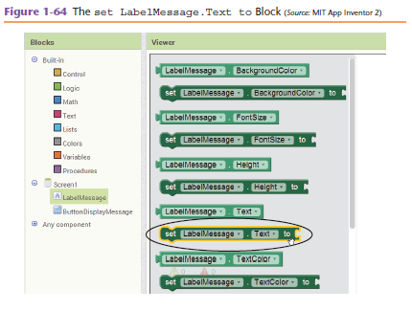
Getting Hands-On with App Inventor

Slide 63
Getting Hands-On with App Inventor
Programming in Blocks
To insert the block you click and drag it to the empty space inside the
when ButtonDisplayMessage.Click do block.
The set LabelMessage.Text to block is not a complete instruction.
Noticed the opening on the right edge of the set LabelMessage.Text to block.
You need to snap another block specifying a value into the socket.

Slide 64
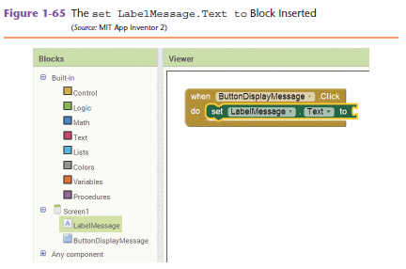

Getting Hands-On with App Inventor

Slide 65
Getting Hands-On with App Inventor
Programming in Blocks
Click Text under Built-in in the Blocks column.
A drawer will open as shown in Figure 1-67.
In the figure is the text string block.
Click the empty space, type Hello World then press enter.

Slide 66
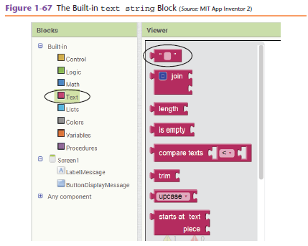
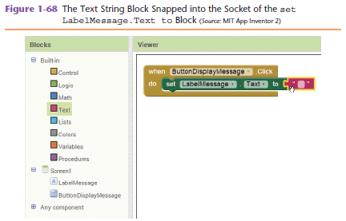
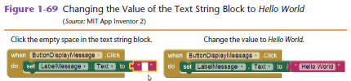
Getting Hands-On with App Inventor

Slide 67
Mole Mash Game

Slide 68
Mole Mash Game Description
In our version of whack a mole, you will have thirty seconds to try and get the highest score you can. If your total score after the thirty seconds is high enough, you will be able to collect bonus points by shaking your device! Final Scores are then displayed on another we will call the ScoreScreen. On the ScoreScreen page, the high score is displayed along with the score from the previous game.

Slide 69
Android & Computer Science Concepts Covered in Mole Mash Game
This Android App will include the following Computer Science concepts and Android principles:
The Android accelerometer sensor
Android event handling
How conditional and control statements are used
Data structures and Abstractions
Parameter passing and Data Storage
High level languages translated into low level languages.

Slide 70
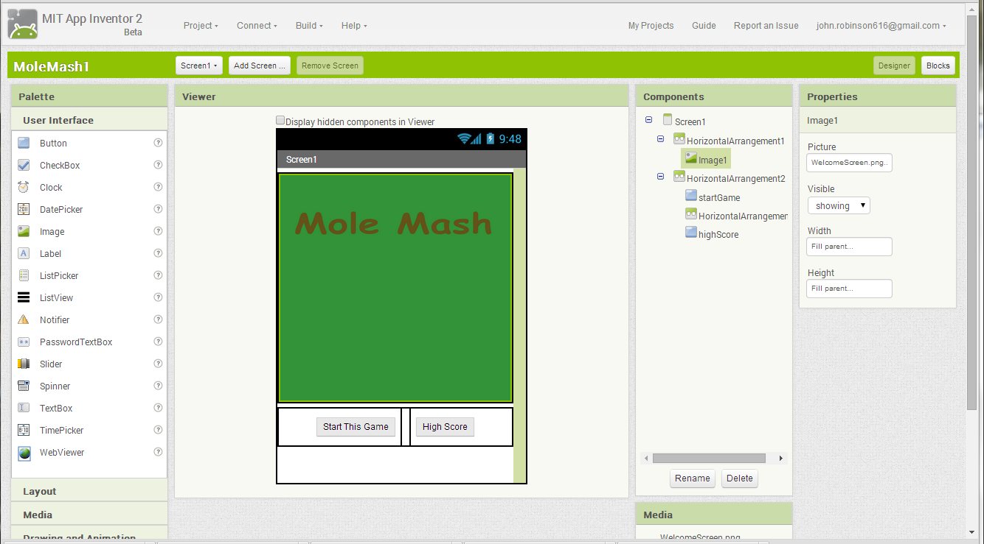
Screen 1
Notes:
HZL1 – width – fill parent, height - 310 pixels
HZL2 – width – fill parent, height - 50 pixels
HZL3 – width – 10 pixels, height – fill parent

Slide 71
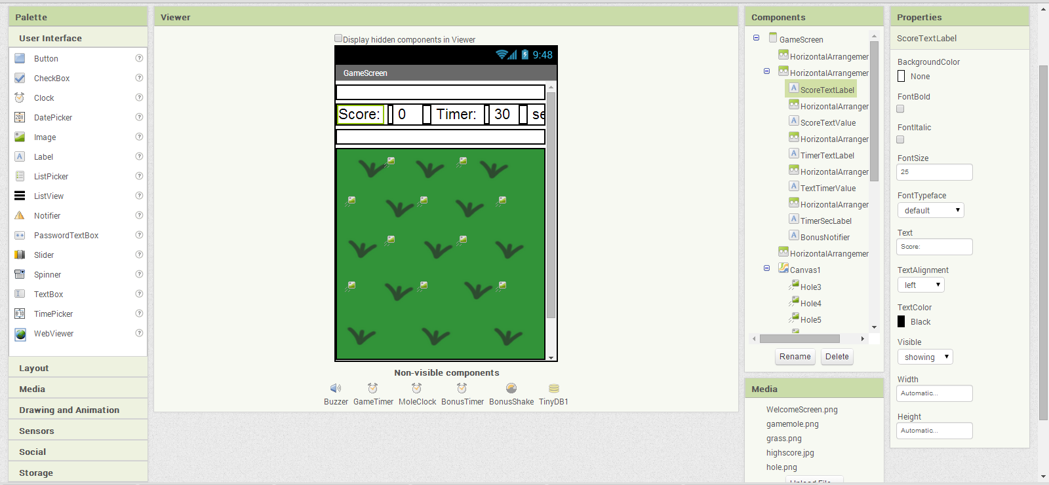
Game Screen top
Notes:
HZL1 – width – fill parent, height - 20 pixels
HZL2 – width – fill parent, height – automatic
HZL3 – width – 5 pixels, height - fill parent
HZL4 – width – 10 pixels , height - fill parent
HZL5 – width – 5 pixels, height - fill parent
HZL6 – width – 10 pixels, height – fill parent
HZL7 – width – fill parent, height - 20 pixels
CANVAS - width – fill parent, height - 320 pixels

Slide 72
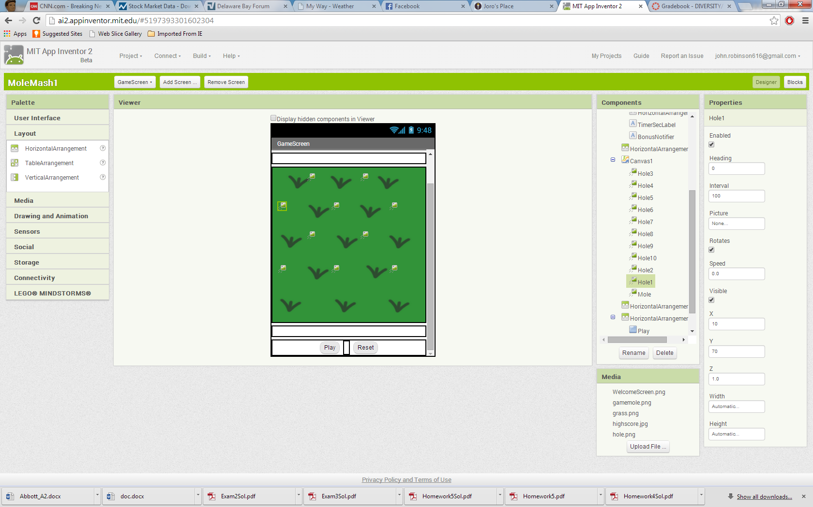
Game Screen bottom
Notes:
HZL8 – width – fill parent, height - 20 pixels
HZL9 – width – fill parent, height - 20 pixels
HZL8 – width –10 pixels, height - fill parent

Slide 73
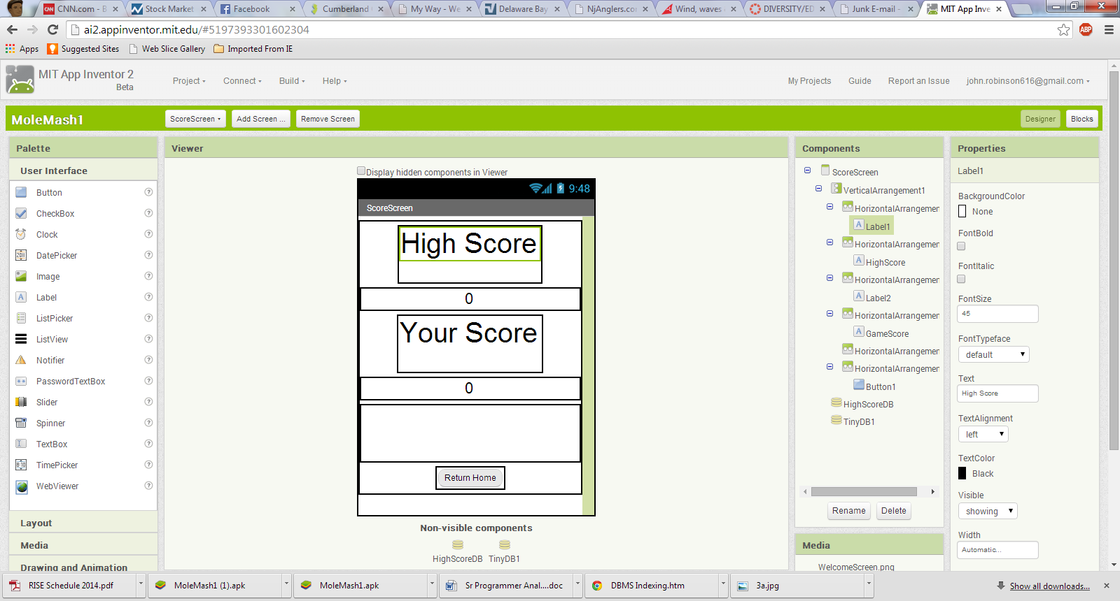
Score Screen
Notes:
VERTL1 – width – fill parent, height - fill parent
HZL2 – width – automatic, height – 80 pixels
HZL3 – width – fill parent, height – automatic
HZL4 – width – automatic, height – 80 pixels
HZL5 – width – fill parent, height – automatic
HZL6 – width – automatic, height – 80 pixels
HZL7 – width – automatic, height – fill parent

Slide 74
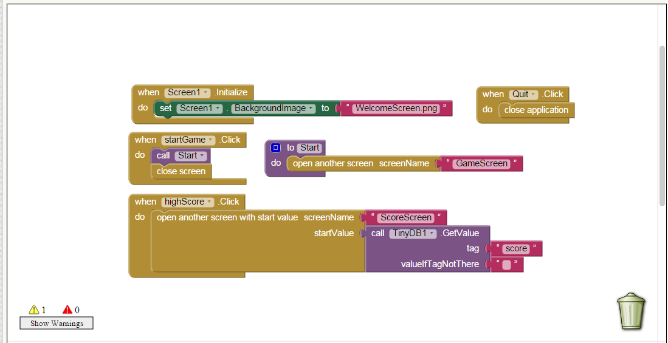
Screen 1 Logic

Slide 75
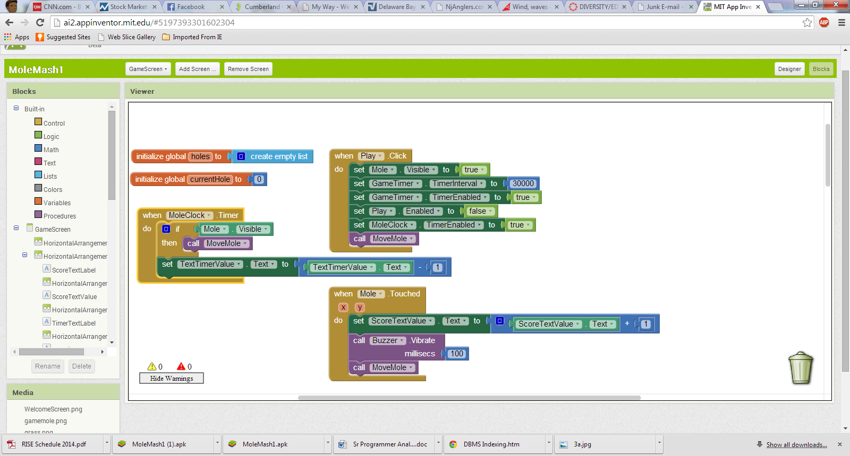
Game Screen Logic

Slide 76
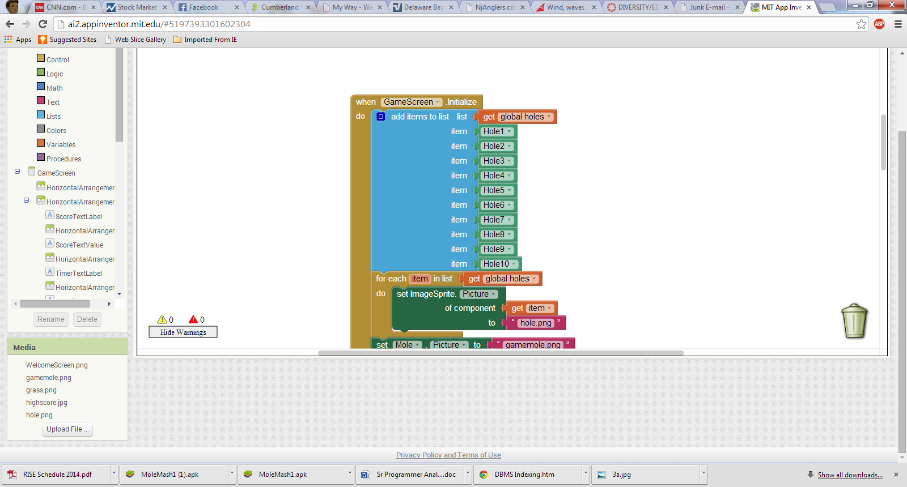
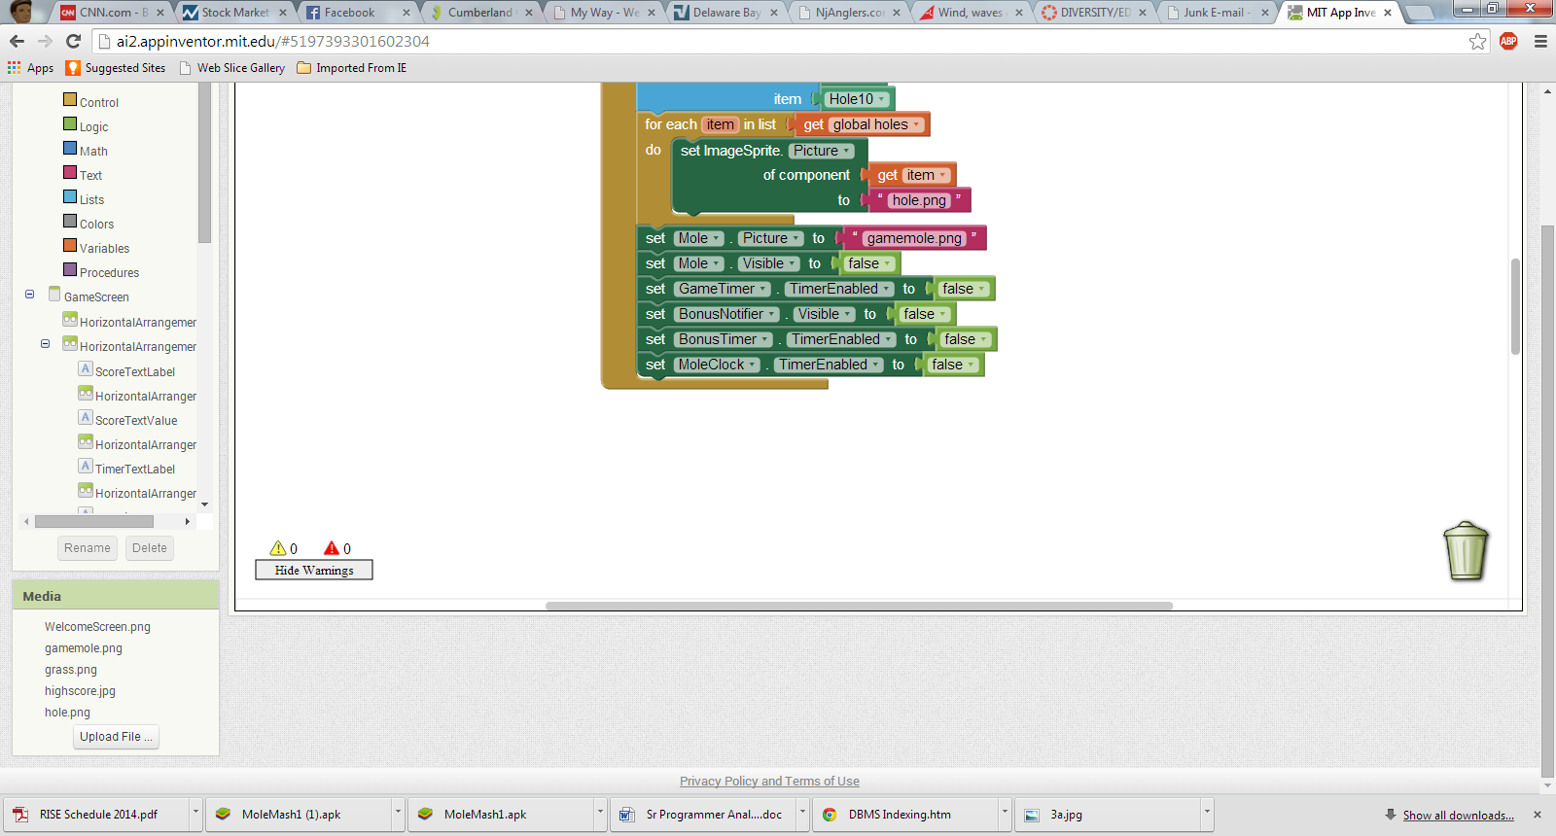
Game Screen Logic

Slide 77
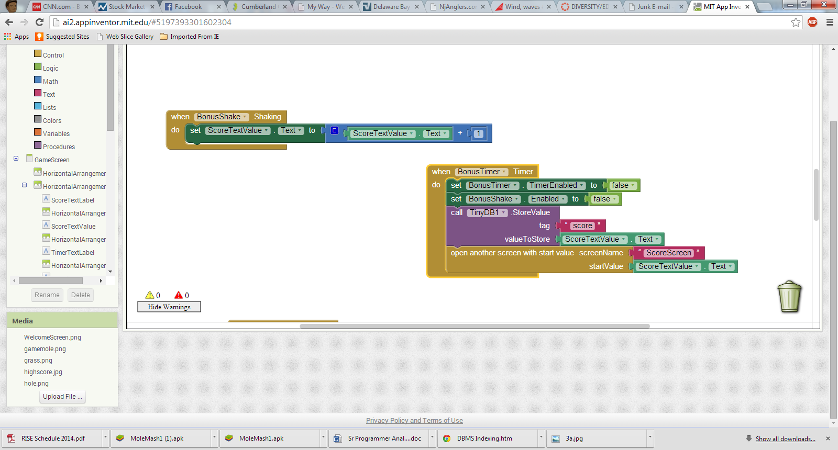
Game Screen Logic

Slide 78
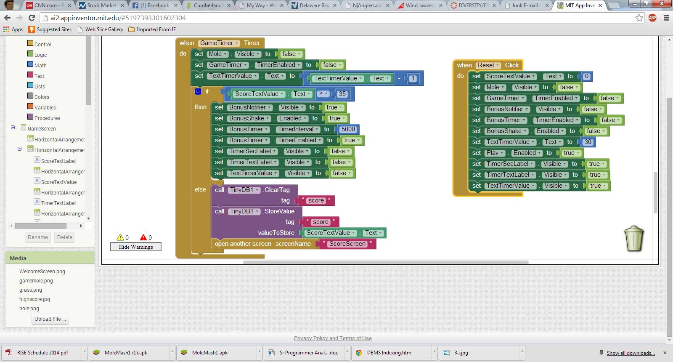
Game Screen Logic

Slide 79
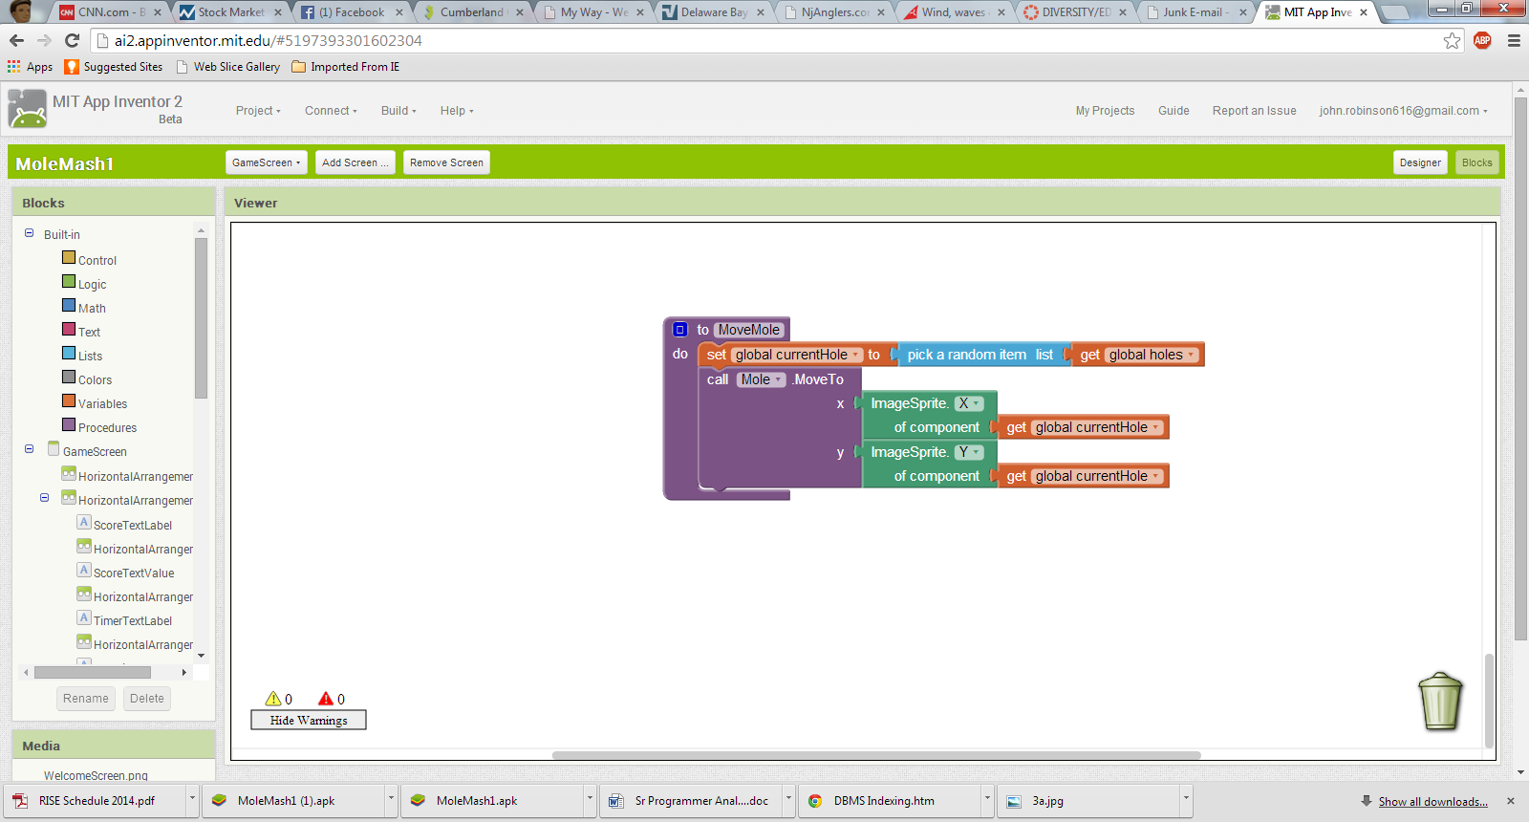
Game Screen Logic

Slide 80
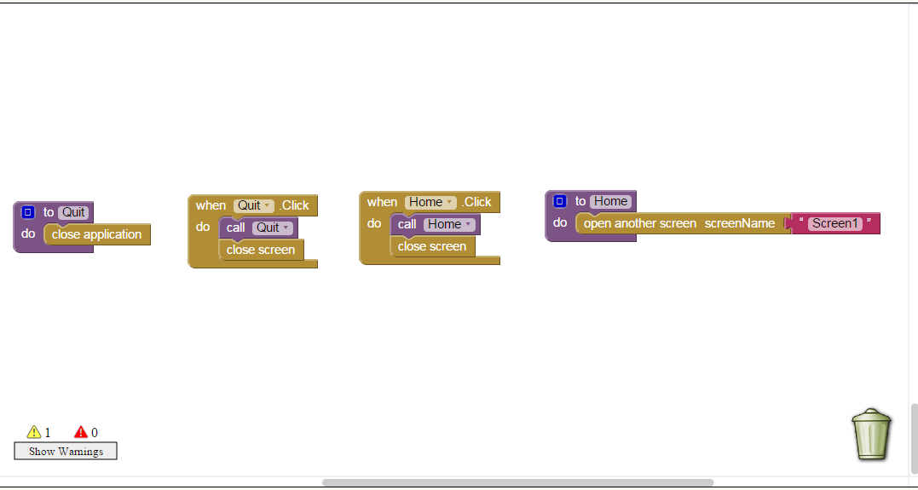
Game Screen Logic

Slide 81
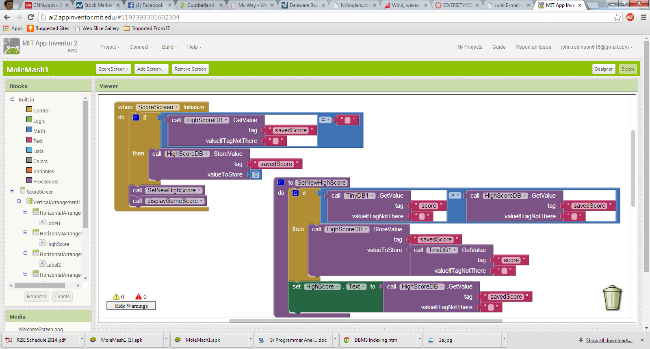
Score Screen Logic

Slide 82
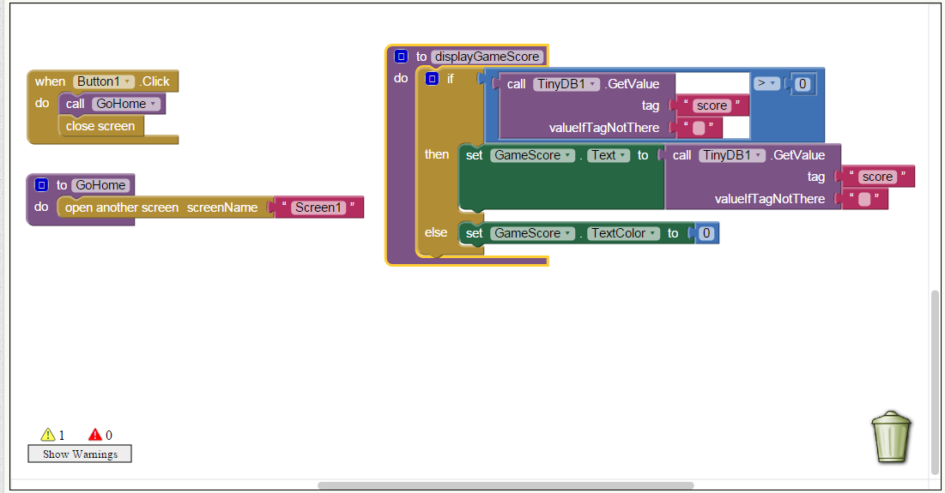
Score Screen Logic

